Slide 1

Finding our Home in a Globalized World
Alejandro Dueñas García

Slide 2

A Globalized World
Financial markets are very interconected
Posibility to work anywhere
Health is an important factor

Slide 3
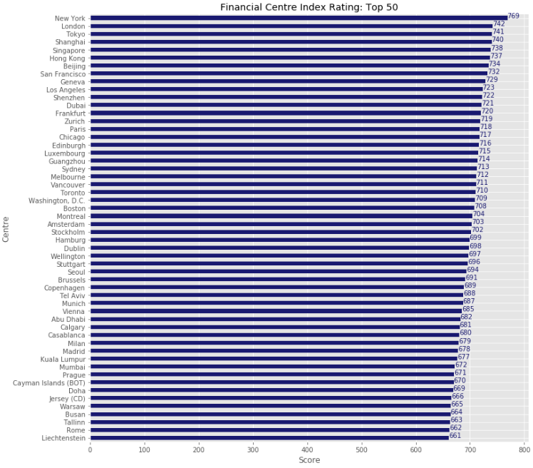
Which are the Top Financial Centres around the World?

Slide 4
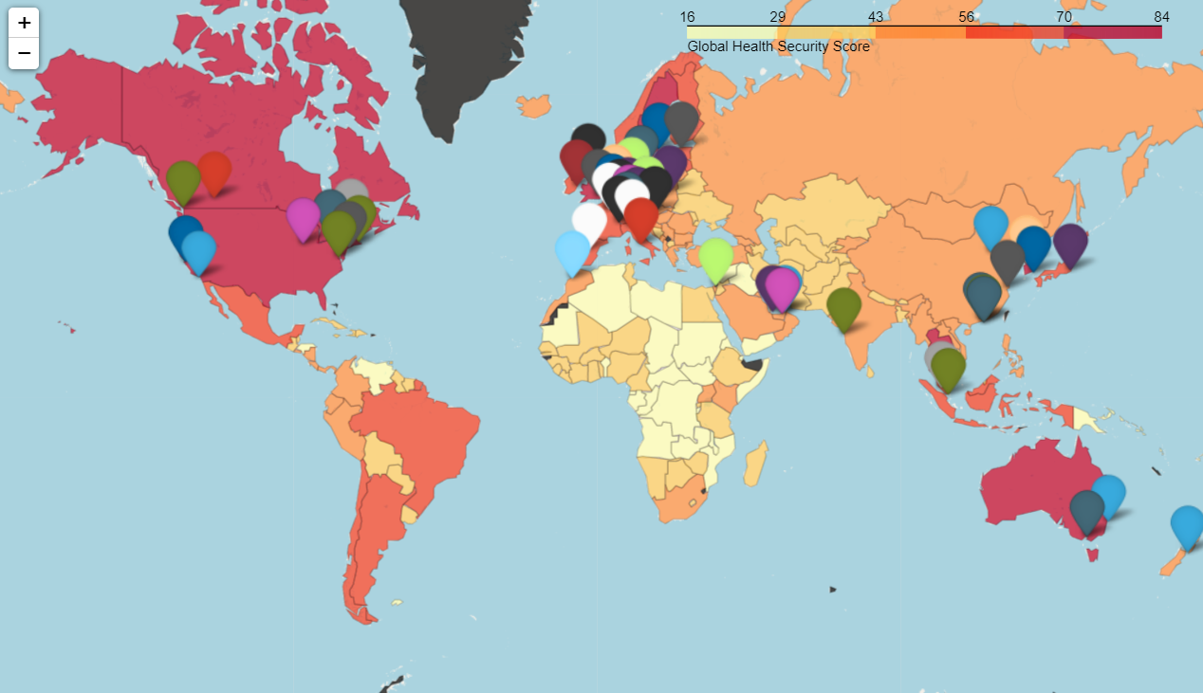
Top 50 Financial Centres and GHS Index

Slide 5
Financial Centres in a COVID19 context
First observations:
Most of the top 50 financial centres are in the best ranked countries to manage a pandemic.
The mean of the GHS index for these cities is 63.9 vs 40.2 of all the world.
Most of the top 50 financial centres are in developed countries, particularly those in Europe and North America.
The cities that are not in developed countries are in the South-East Asia or Middle-East rich countries.
As a result of the COVID 19 pandemic the capabilities to manage this kind of problem of each country is a very important factor

Slide 6
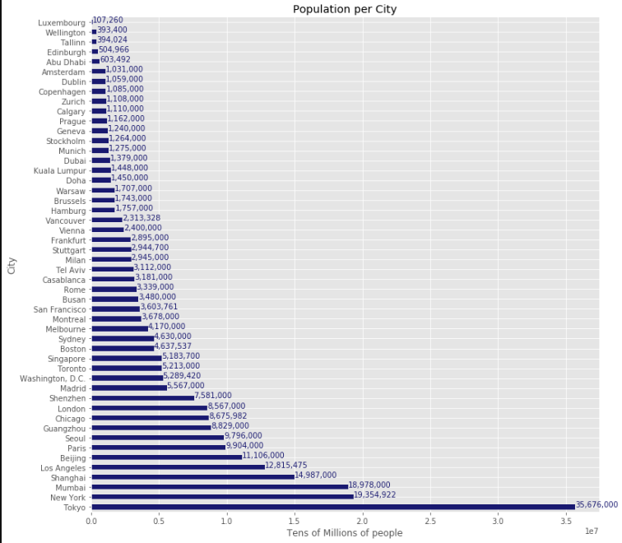
Population is also a key factor
The population of a city is an indicator of the city’s size, mobility and how hectic it can be.
The top financial centres show a great variety of population sizes, being an important factor for classifying the cities in clusters

Slide 7
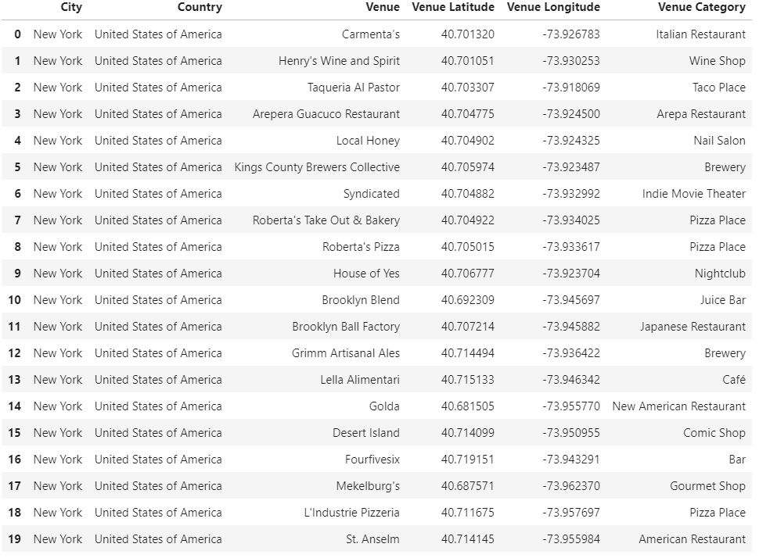
Foursquare API: differenciating by venues
Using the Foursquare API we can characterize cities by the types of venues, giving a deeper insight of what can be expected to be found in each financial centre.
This is a key factor due to cultural preferences, entertainment options and specific interests of each client.

Slide 8
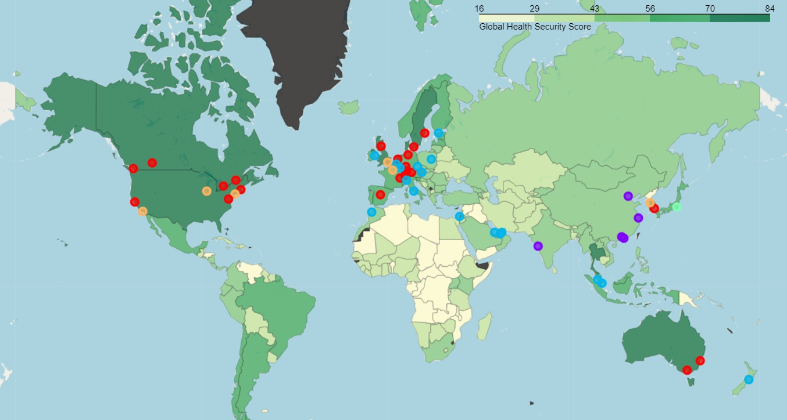
Clustering Possible Candidates

Slide 9
Financial Centres in a COVID19 context
Final observations:
There is a concentration of financial centres in developed countries, which are more capable to respond to a new pandemic.
An important trait is the population size: top financial centres come in a wide range of populations
The result of the clustering algorithm (K-means) shows that the GHS Index is an important characteristic in order to differenciate cities (the blue cluster tends to have a lower GHS index score).
South-East Asia cities have a differenciating traits, which can be associated to a different type of venues found there. This opens an interesting cultural factor to consider.

